Slide 1
LEAD SCORING CASE STUDY
Submitted By: Parth Patpatiya

Slide 2
Problem Statement
A model is to be formed that will allocate a lead score to each lead, wherein consumers who have higher lead scores exhibit a greater likelihood of conversion, while customers with lower lead scores demonstrate a diminished likelihood of conversion.

Slide 3
Importing Libraries
import pandas as pd
import numpy as np
import matplotlib.pyplot as plt
import seaborn as sns
import statsmodels.api as sm
from sklearn.model_selection import train_test_split, GridSearchCV, cross_validate
from statsmodels.stats.outliers_influence import variance_inflation_factor
from sklearn.preprocessing import MinMaxScaler
from sklearn.feature_selection import RFE
from sklearn.linear_model import LogisticRegression
from sklearn.metrics import confusion_matrix, roc_curve, roc_auc_score, precision_score, recall_score, precision_recall_curve, f1_score, accuracy_score

Slide 4
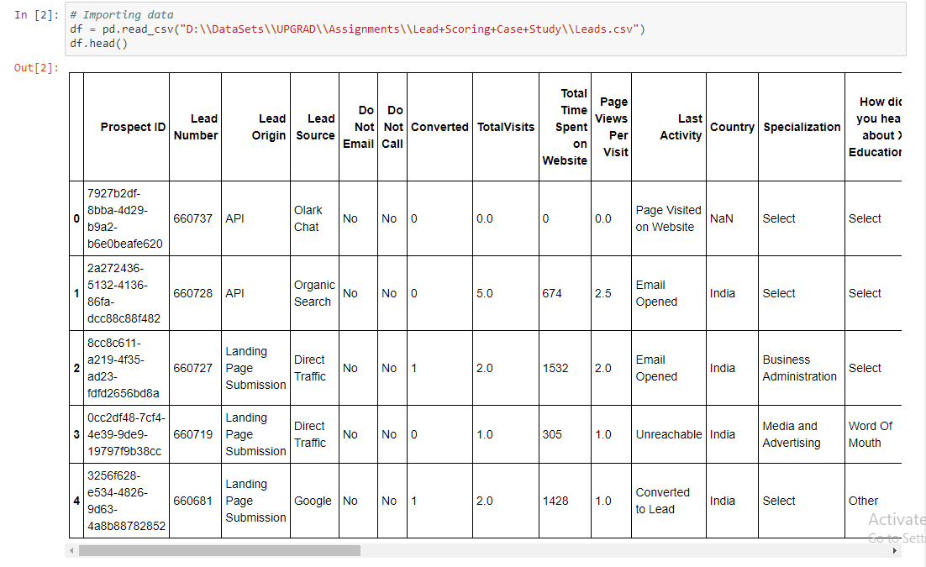
Importing Data

Slide 5
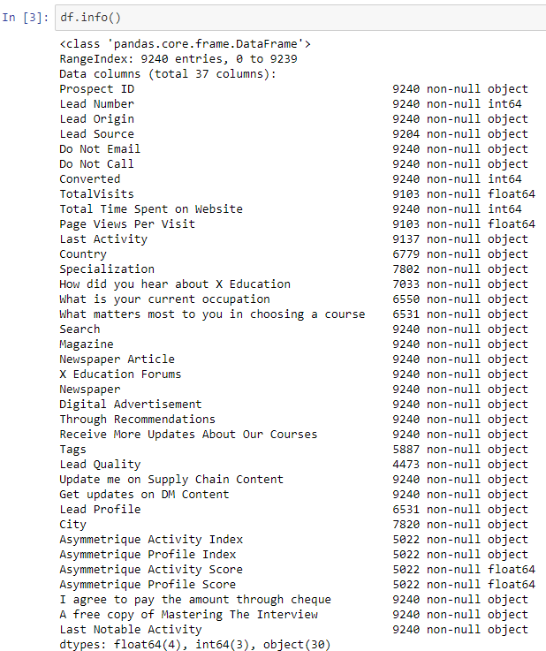
Checking Null Values

Slide 6
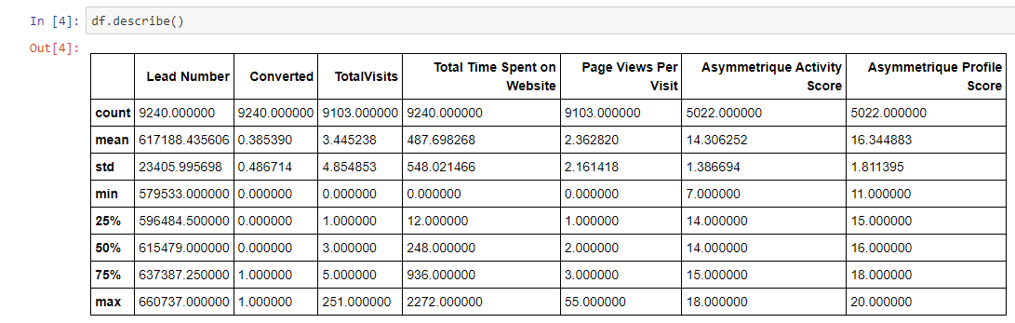
Checking mean, median and mode

Slide 7
Data Cleaning
There are several columns that exist inside a dataset that contain only one category, resulting in redundancy.
In the column lead_score: WeLearn and WeLearnblog_home are similar.
‘Select’ in How Did You Do, Specialization, City is NaN.
There is a potential for the presence of overlaps in the City column.
There are two distinct categories for "Asia/Pacific Region" and "Asian Countries" in the table's column labeled "Australia" for the nation.
The entry ‘select’ are equivalent to NaN.

Slide 8
Working with Nan (not-a-number) values
Imputed Values: 'how_did_you‘, lead_profile
Asymmetrique scores: 'profile_score', 'activity_score‘
Dropping Values: 'asymmetrique_profile_score', 'asymmetrique_activity_score
Eliminating prefixes from 'asymmetrique_profile_index‘
Replacing NaN with mode value in 'asymmetrique_activity_index‘
Droping na values in ['totalvisits', 'page_views_per', 'lead_source'

Slide 9
Creating Dummy variables
Creating dummy entries for 'object‘ column

Slide 10
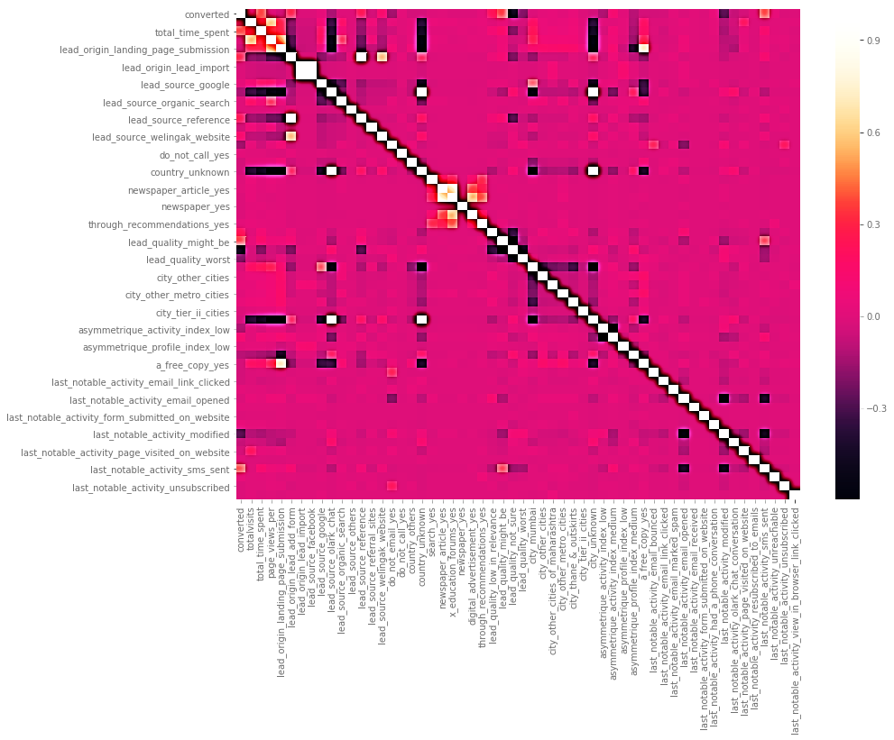
Exploratory Data Analysis (EDA)

Slide 11
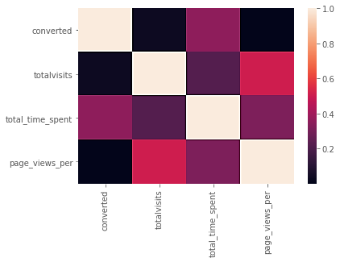

Slide 12
Removing highly correlated variables
['lead_source_facebook', 'lead_origin_lead_add_form', 'lead_source_olark_chat']

Slide 13
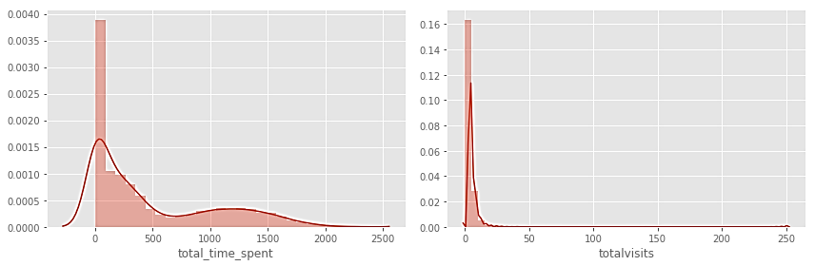
Outlier Detection and Univariate Analysis (Bar Plot and Subplot)

Slide 14
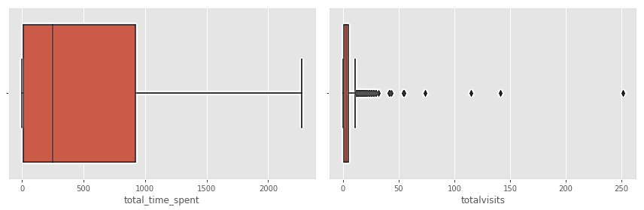
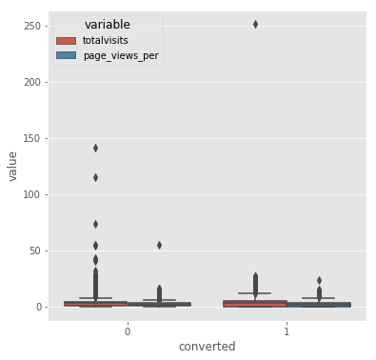

Slide 15
Bivariate Analysis
Pair Plot framed for the variables:
['totalvisits', 'page_views_per', 'total_time_spent']

Slide 16
Linear Predictive Model
Steps for building the predictive model:
Splitting the model(train_test_split)
scaler=MinMaxScaler() [X__train, X_test]
Recursive Feature Elimination (RFE) & Cross Validation
Variable Influence Factor Analysis
Receiving Operating Characteristic Curve
Sensitivity

Slide 17
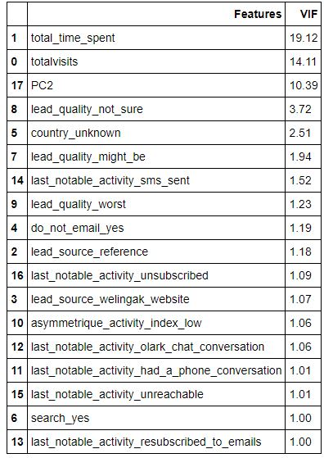
Variable Influence Factor Analysis

Slide 18
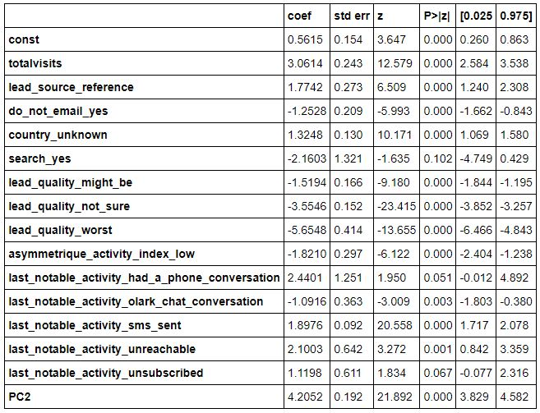
Statistical Model Assesment
Statsmodels.api

Slide 19
Optimal Cut off value
Optimal Cut off value=0.32
Sensitivity (Recall): 0.78
Specificity: 0.91
Precision: 0.83
F-Score: 0.79

Slide 20
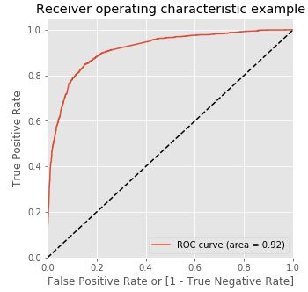
Receiving Operating Characteristic Curve

Slide 21
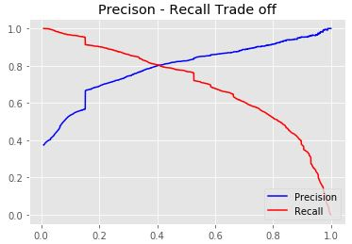
Precision & Recall

Slide 22
Conclusion
Ultimately, our Logistic Regression model has an overall accuracy of about 0.85. It may be inferred that there exists an 85% probability of successful conversion for the leads that have been anticipated. This achieves the objective of achieving a minimum of 80% lead conversion.

